Slide 1
Recurrent Neural Network
Introduction

Slide 2
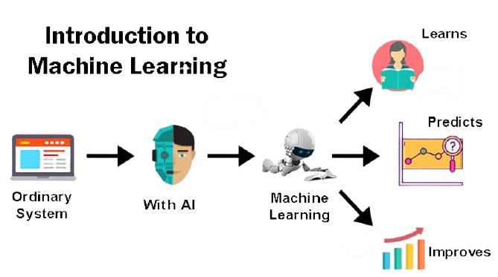
Feature Extraction
Feature Selection
Small data sets
With large data sets with large Features ➔very difficult to do feature engineering

Slide 3
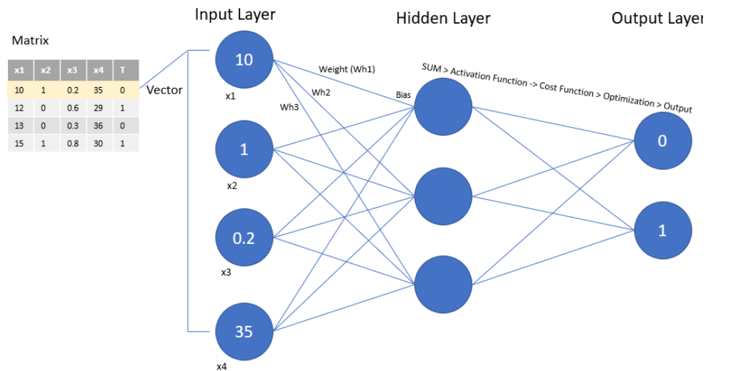
Feed Forward Network (ANN)
Auto Feature Engineering
Activation function, Bias, Weights
Capable of learning any non-linear function
➔Universal function approximator

Slide 4
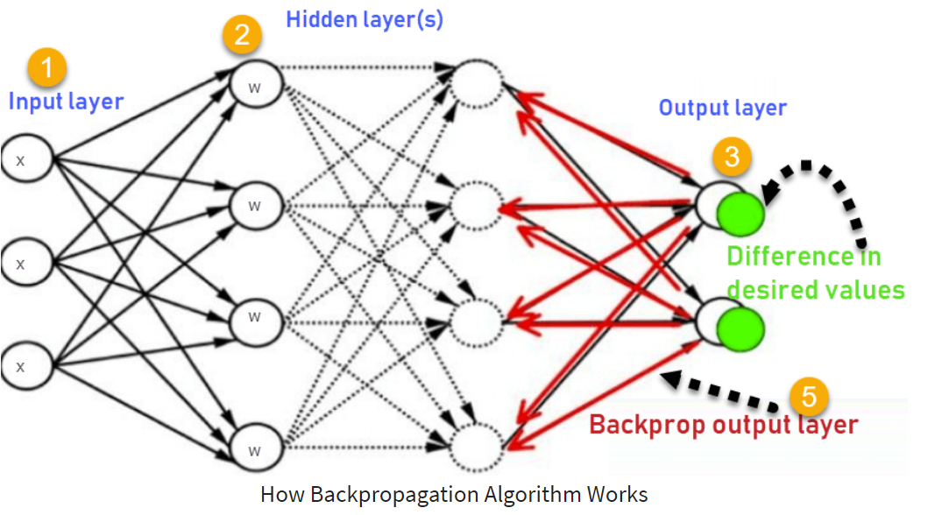
Backpropagation to reduce errors

Slide 5
Problems cannot be handled by ANN due to huge input of features which increases the time complexity
1- Image Recognition
2- Speech Recognition
3- Text Recognition
Convolutional Neural Network

Slide 6
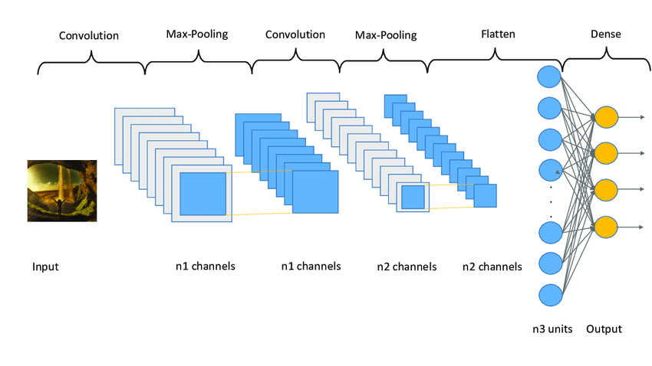
Convolutional Neural Network (CNN)
Reduce Feature extraction by focusing on the most important features
➔Reduce the dimension
➔Apply ANN and SoftMax(dense)

Slide 7
Problems cannot be handled by ANN due to Lack of memory (only one input one output)
1- Time series case
Stock market Analysis
Forecast Revenue Accurately
2- Language translation
3- Image Captions
4- NLP
5- any sequence problem which requests memory
Recurrent Neural Network

Slide 8
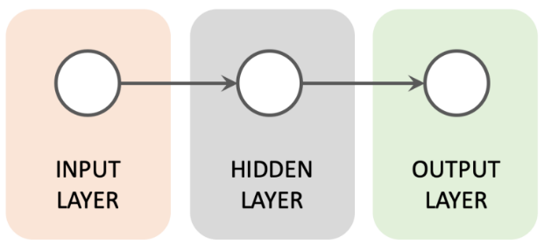
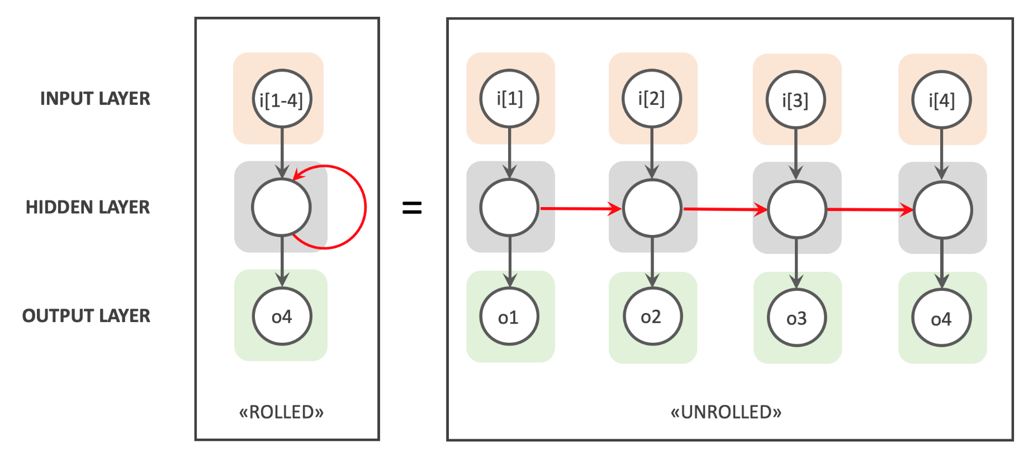
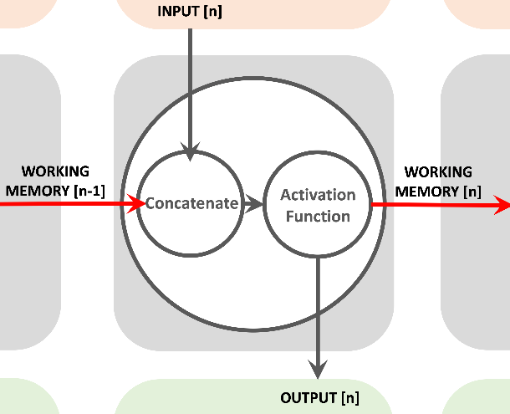
Recurrent Neural Network (RNN)

Slide 9
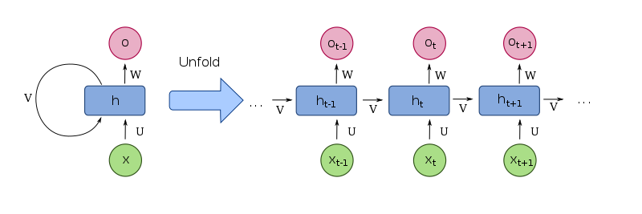
Recurrent Neural Network (RNN)

Slide 10
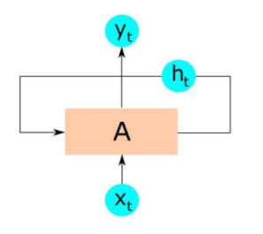
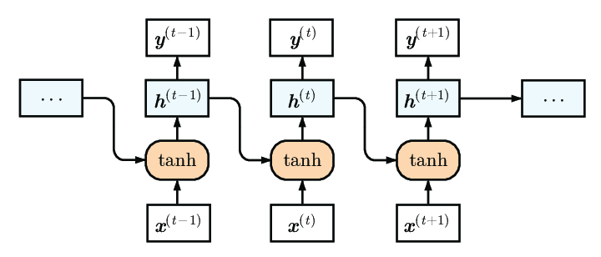
Vanilla Recurrent Neural Network (RNN)
(one-to-one) Timeseries applications

Slide 11
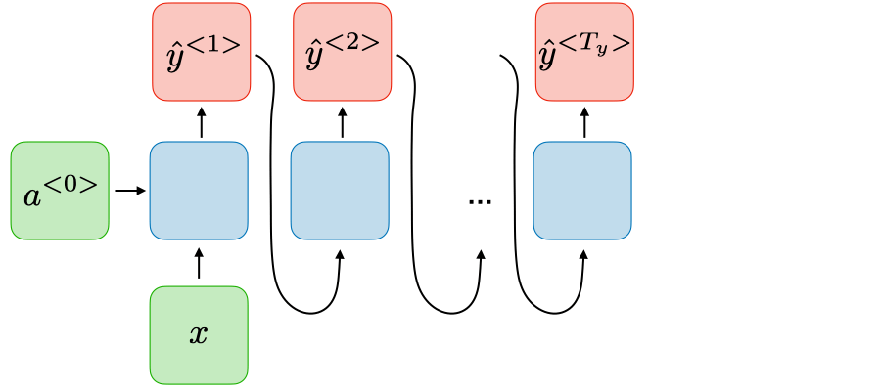
Recurrent Neural Network (RNN)
(one-to-many) Music generations –
Image captioning(one image as input many words as output)

Slide 12
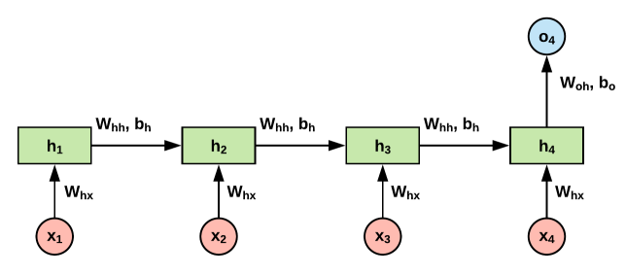
Recurrent Neural Network (RNN)
(many-to-one)
Sequence analysis (a sentence as input, which language as output)

Slide 13
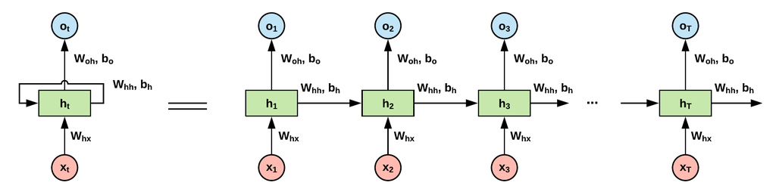
Recurrent Neural Network (RNN)
(many-to-many: sequence input and sequence output)
Language translation, Encodes – decodes

Slide 14
Recurrent Neural Network 101

Slide 15

Job description is to admit
CS Major
MIS Major
CCE Major

Slide 16
1
The admission in major is based on the GPA
GPA> 3
CS
NN
GPA< 3
MIS
NN

Slide 17
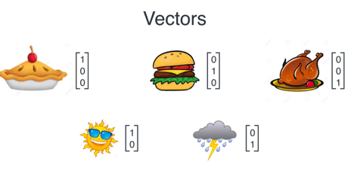
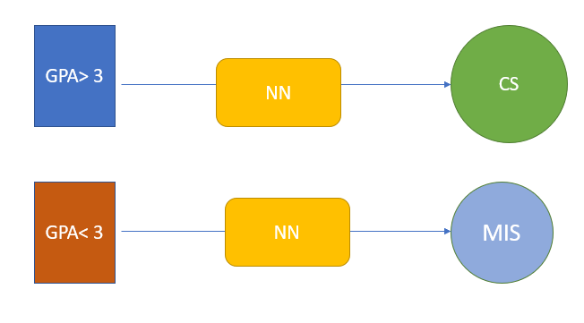




CS
MIS
CCE
GPA> 3
GPA< 3

Slide 18
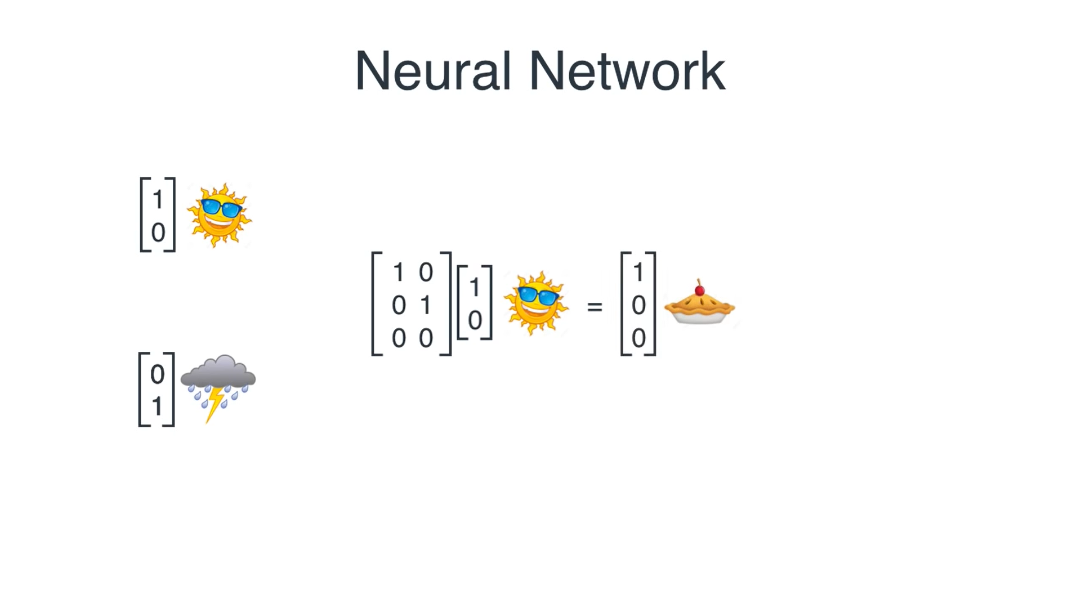
GPA> 3
GPA> 3
CS
GPA< 3

Slide 19
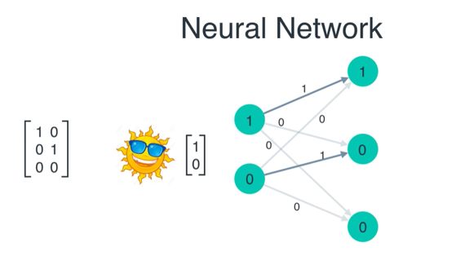
GPA> 3
CS

Slide 20
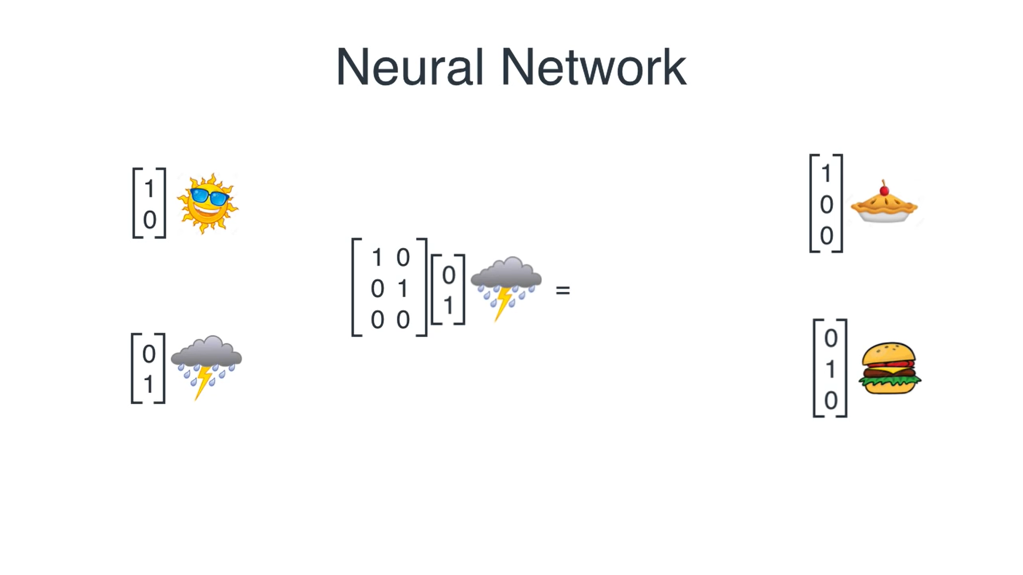

GPA> 3
CS
GPA< 3
GPA< 3
MIS

Slide 21
2
The admission is based on sequence which is not related to GPA
ADMISSION SCHEDULE

Slide 22
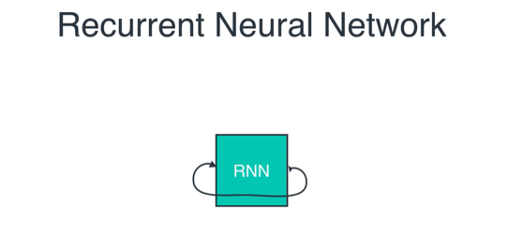
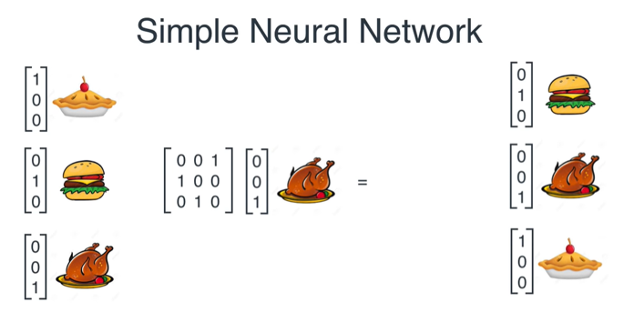
CS
MIS
MIS
CCE
CCE
OUPUT
INPUT
CS
CCE

Slide 23

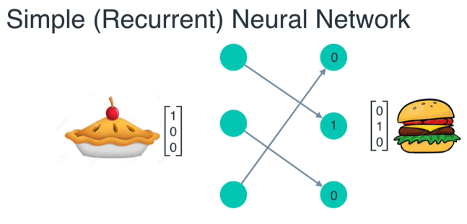
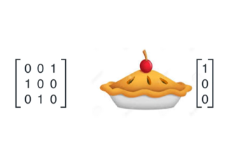
Only draw the lines with 1s
CS
MIS

Slide 24
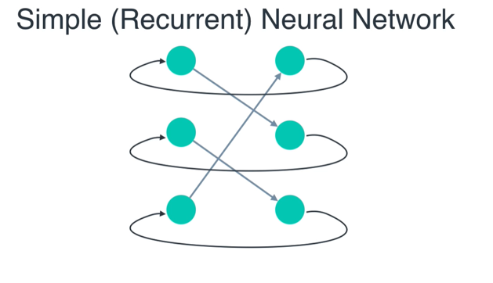

Slide 25
3
The admission is based on combination of gpa rule and sequence
If a person GPA is >3 , he will be admitted in the same major as yesterday
If a person GPA is <3, he will be admitted in a different major
ADMISSION SCHEDULE
Monday | Tuesday | Wednesday | Thursday | Friday | Saturday | Sunday
CS | (3) CS | MIS | CCE | CCE | CS | CS
 | (2 ) check yesterday
 | (1) Gpa>3 | Gpa<3 | GPA <3 | GPA>3 | GPA<3 | GPA>3
Tuesday
Wednesday
CS from Monday
CS FOR TUESDAY
MIS FOR WEDNESDAY
CS from Tuesday
Gpa>3
<3

Slide 26
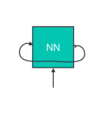
CS
MIS
CCE
GPA> 3
GPA< 3

Slide 27
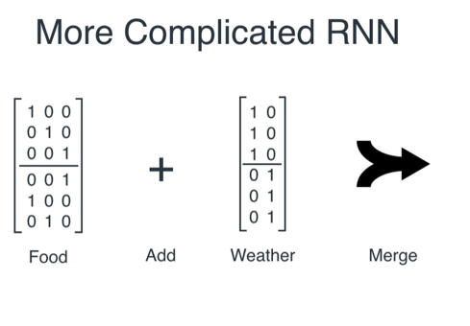
Majors
GPA

Slide 28
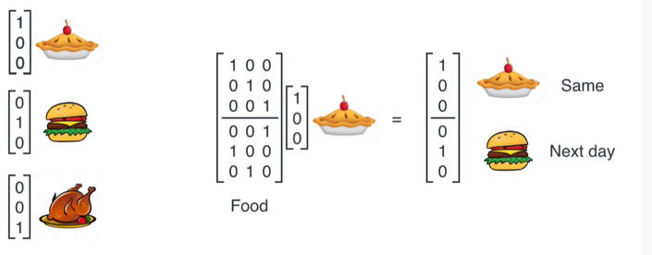
MAJORS
CS
CS
MIS
CS
MIS
Result 1
CCE
Two Layers major matrix

Slide 29
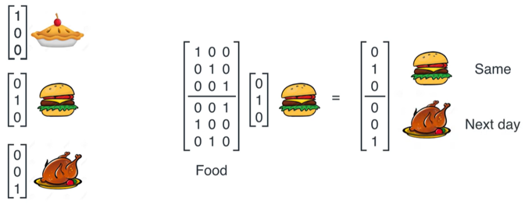
NEXT
CS
MIS
MIS
MIS
CCE
Result 2
CCE
Two Layers major matrix

Slide 30
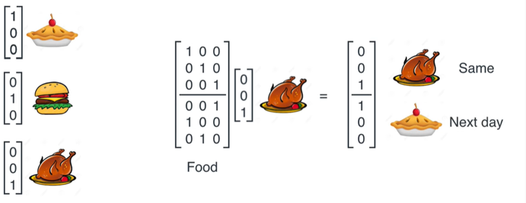
CS
CCE
MIS
CCE
CS
Result 3
CCE
Two Layers major matrix

Slide 31
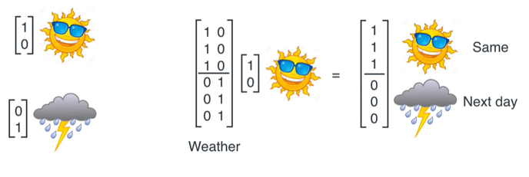
GPA
GPA> 3
GPA> 3
GPA> 3
GPA< 3
GPA< 3
GPA

Slide 32
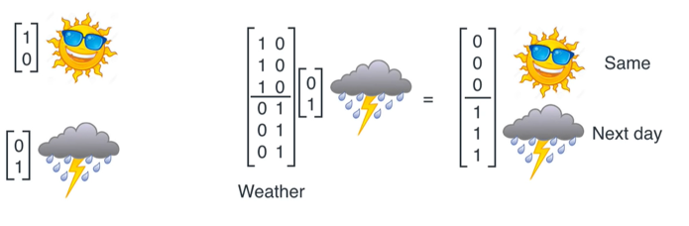
GPA
GPA> 3
GPA> 3
GPA< 3
GPA< 3
GPA< 3
GPA

Slide 33
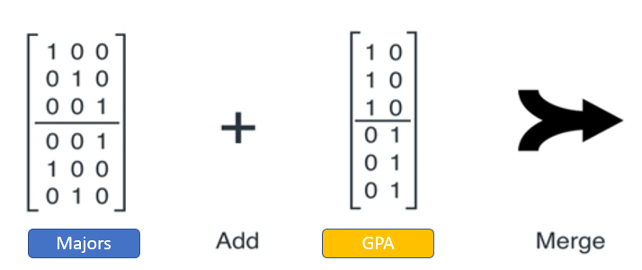
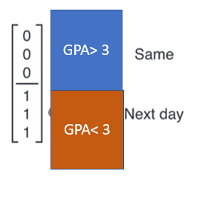
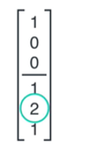
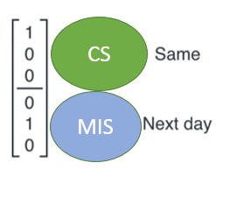
Yesterday
We admitted
CS
?
GPA< 3
GPA of today’s person
=
+

Slide 34
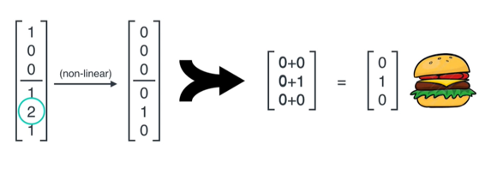
MIS
? = What is the decision ?
Yesterday
We admitted
CS
?
GPA< 3
GPA of today’s person
MIS
Hot encoding(max value)

Slide 35
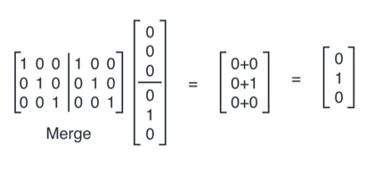
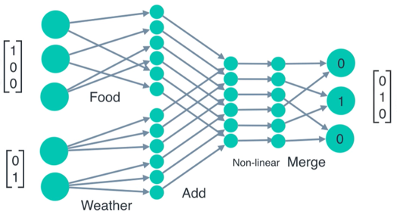
Merge As a RNN
Merge As a matrix
Major
GPA

Slide 36
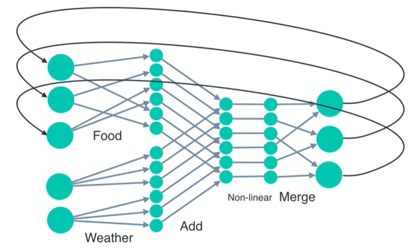
Major IN
CS
Major OUT
Major
MIS
GPA

Slide 37

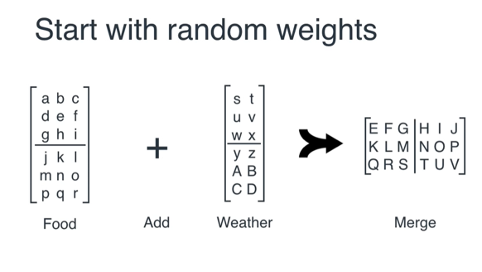

Majors
GPA

Slide 38
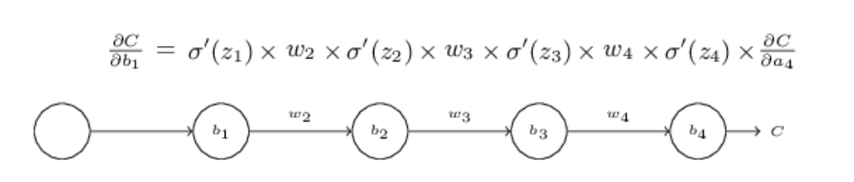
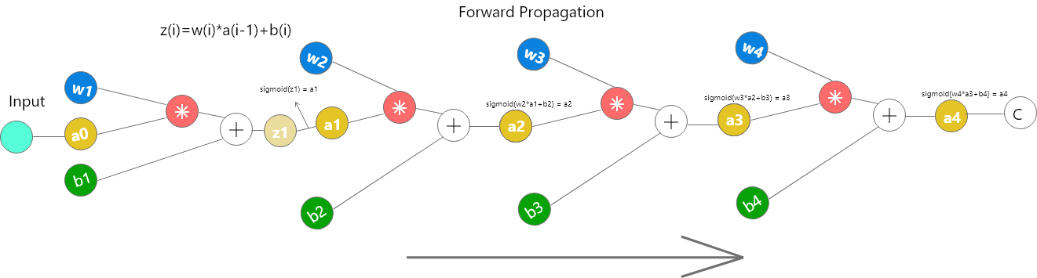

Slide 39
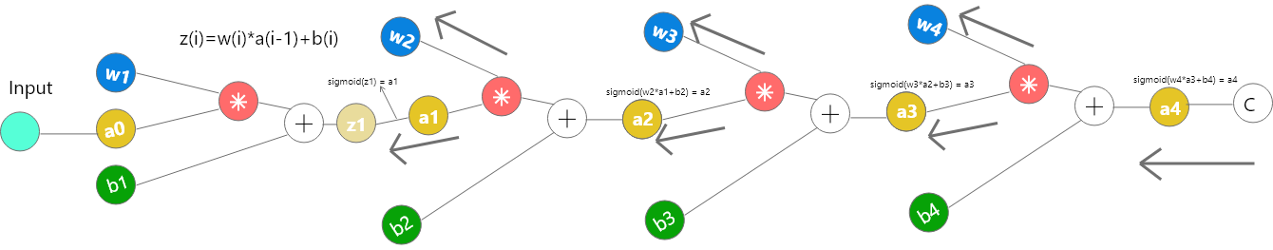
we train a Deep model using through backprop using Gradient Descent, we calculate the gradient of the output w.r.t to weight matrices and then subtract it from respective weight matrices to make its(matrix’s) values more accurate to give correct output
When the gradient becomes negligible, subtracting it from original matrix doesn’t makes any sense and hence the model stops learning. This problem is called as Vanishing Gradient Problem (W get smaller exponentially) Exploding gradient descent (W get larger exponentially)

Slide 40
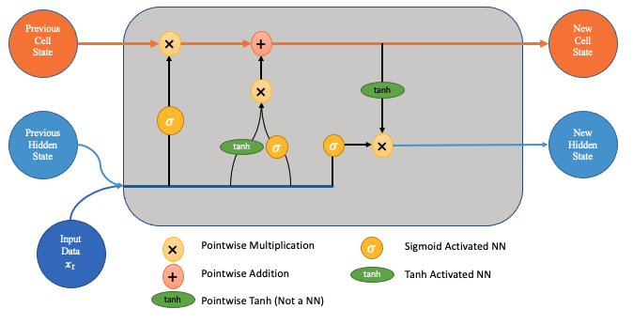
LSTM ( Long Short Term Memory :
=➔adding C:cell state =memory))

Slide 41
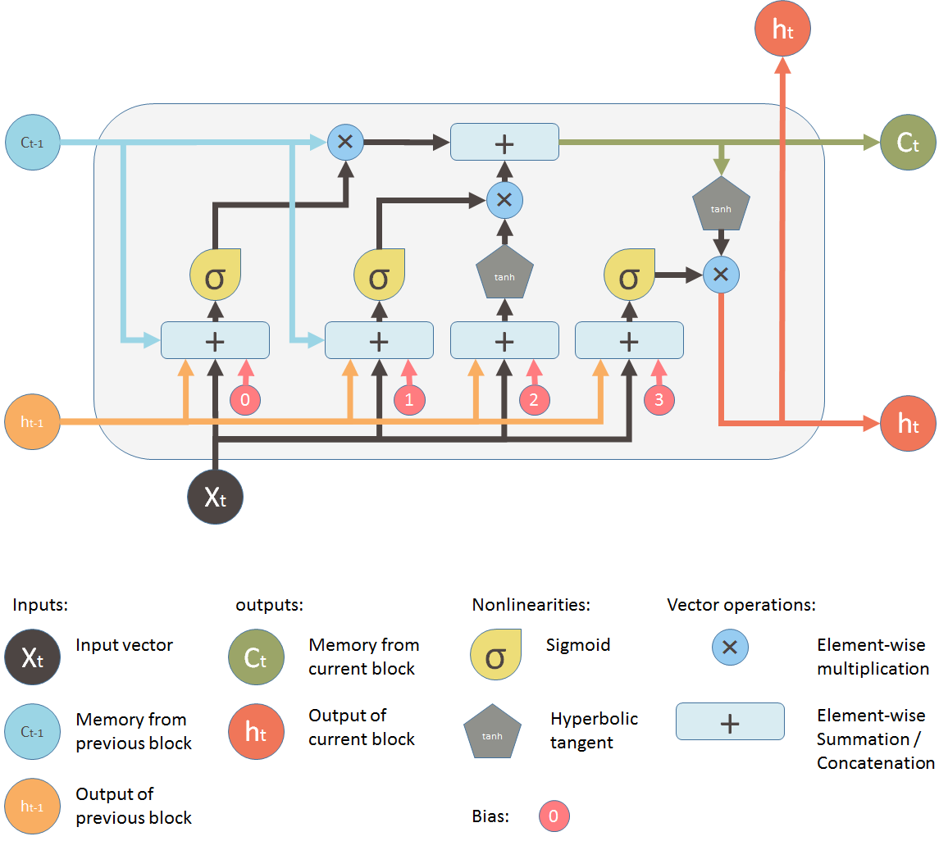

Slide 42
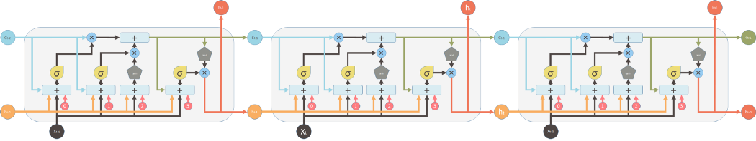
LSTM ( Long Short Term Memory :adding C:cell state =memory ➔the c flows in the network)
C_t changes

Slide 43
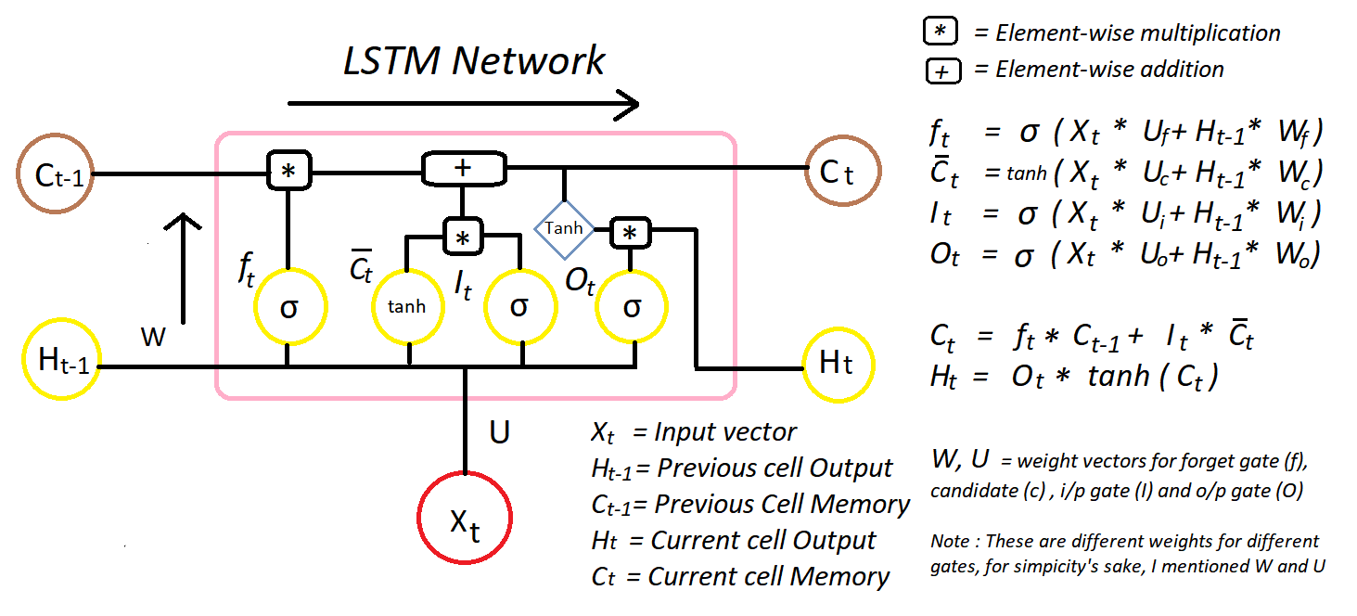

Slide 44
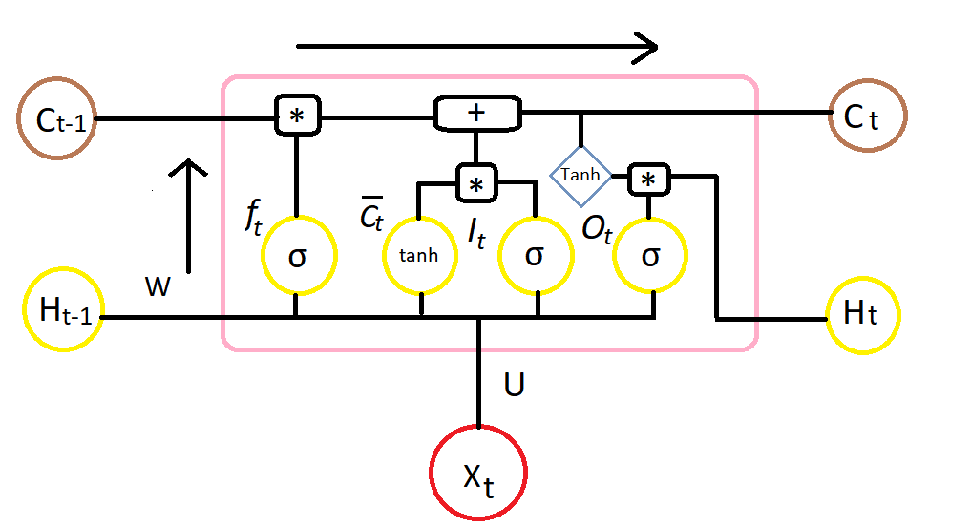
Forget Gate “f” ( a neural network with sigmoid)
Candidate layer “C`"(a NN with Tanh)
Input Gate “I” ( a NN with sigmoid )
Output Gate “O”( a NN with sigmoid)
Hidden state “H” ( a vector )
Memory state “C” ( a vector)

Slide 45
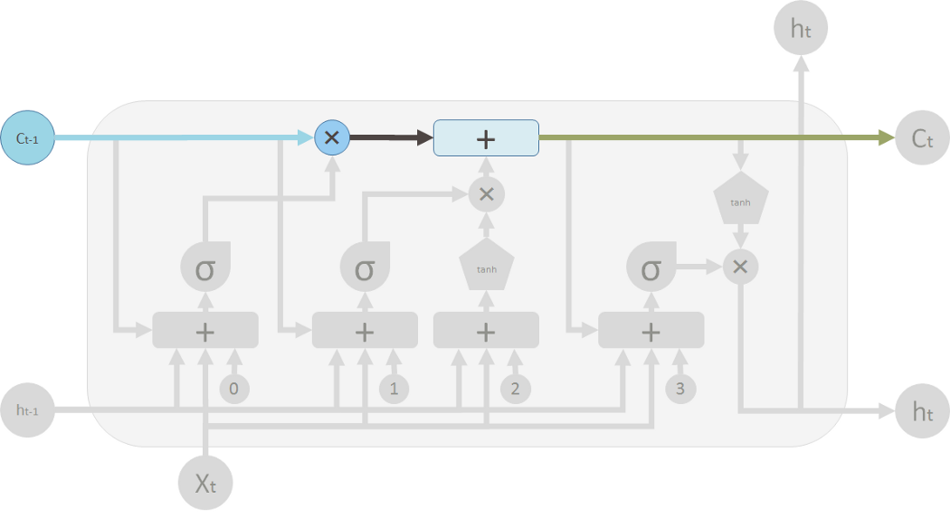
Element wise operation
0➔delete memory
1➔ pass it through
piece wise operation
➔merge old and new memory
Old memory
Forget Gate “f” ( a neural network with sigmoid)

Slide 46
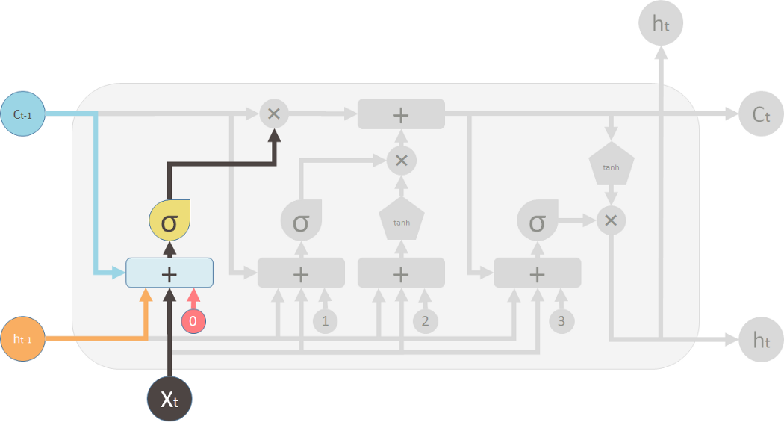
Forget gate f NN with sigmoid
[2,5,3]
[2,0,0]
(forgetting 5 and 3)
Output from Sigmoid function
[1,0,0]
Output from previous LSTM

Slide 47
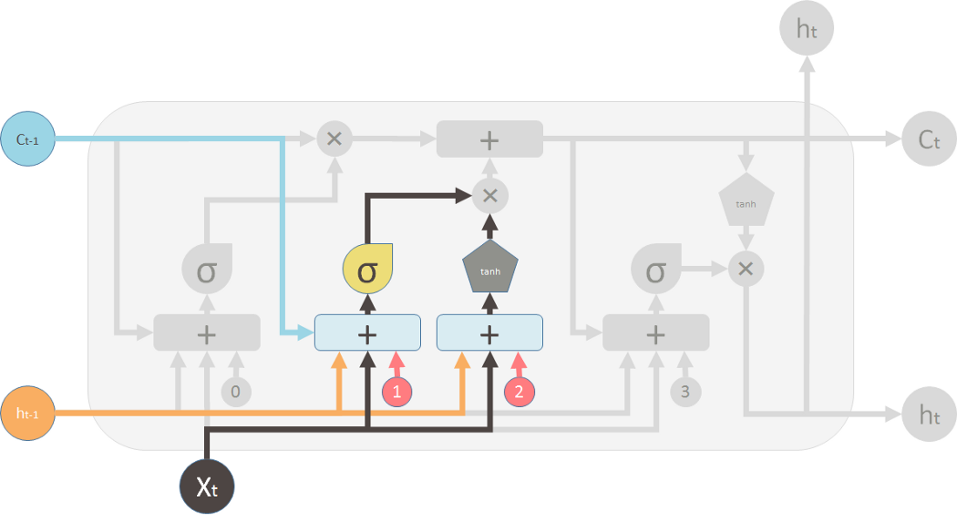
Input Gate with sigmoid (new memory Gate)
&
Candidate Layer NN with Tanh
New memory from Sigmoid function
Tanh controls how much the new memory should influence the old memory.

Slide 48

Output Gate with sigmoid (new memory Gate)
&
Layer NN with Tanh
New memory from Sigmoid function
(3) Is the bias
Tanh controls how much the new memory should be transferred to the second LTSM

Slide 49

CELL:merge the old memory
and the new memory to form C_t
(in green, flows back to the big “Cell”):
Output Gate with sigmoid
Forget gate f NN with sigmoid
Input Gate with sigmoid (new memory Gate)
&
Candidate Layer NN with Tanh

Slide 50


Slide 51




Long Short-term Memory (LSTM)
Other part of the network
Special Neuron: 4 inputs,
1 output
Signal control
the output gate
(Other part of
the network)
Output Gate
Memory Cell
Forget
Gate
Signal control the forget gate
(Other part of the network)
Signal control the input gate (Other part of the network)
LSTM
Input Gate
Other part of the network

Slide 52



𝑎 = ℎ 𝑐′ 𝑓 𝑧_{𝑜}
𝑧_{𝑜}
multiply
Activation function f is usually a sigmoid function
Between 0 and 1
Mimic open and close gate
𝑓 𝑧_{𝑜}
ℎ 𝑐′
𝑐 𝑓 𝑧_{𝑓}
𝑐c′
𝑧_{𝑓}
𝑐𝑓 𝑧_{𝑓}
𝑔 𝑧 𝑓 𝑧_{𝑖}
multiply
𝑔 𝑧
𝑐′ = 𝑔 𝑧 𝑓 𝑧
+ 𝑐𝑓 𝑧
𝑓 𝑧_{𝑖}
𝑖
𝑓
𝑧
𝑖
𝑧

Slide 53
Example in Python
Data is preprocessed into integer sequences where each number corresponds to a word.
Sequences are padded to ensure consistent input size for the RNN.
The Embedding layer converts word indices into dense vectors of fixed size.
LSTM layer captures long-term dependencies in text sequences.
Dropout helps reduce overfitting by randomly turning off neurons during training.
Dense(sigmoid) outputs a probability (0 = negative, 1 = positive).
The model is trained for 5 epochs with accuracy and loss tracked.
Finally, accuracy/loss curves are plotted to visualize performance trends.

Slide 54


Slide 55


What is an Embedding Layer?
The embedding layer represents data, such as words or categories, in a more meaningful form by converting them into numerical vectors

Slide 56

Embedding(input_dim=vocab_size, output_dim=embedding_dim, input_length=maxlen)

Slide 57


Slide 58


Slide 59



Slide 60
Predict the number of positive and negative reviews of a movie using deep learning algorithms.
https://www.kaggle.com/datasets/lakshmi25npathi/imdb-dataset-of-50k-movie-reviews
Train an LSTM-based RNN on IMDB reviews.
2. Plot accuracy/loss to check for overfitting or underfitting.
3. Use IMDB's word index to preprocess custom text reviews.
4. Model outputs a probability → threshold at 0.5 for Positive/Negative classification.

Slide 61


Slide 62


Slide 63



Slide 64


Slide 65
Extend with
multiclass classification using the Reuters news dataset (46 categories):
➔Binary classification (IMDB sentiment) → Positive/Negative.
➔Multiclass classification (Reuters topics) → Multiple news categories with softmax.
➔confusion matrix heatmap and a classification report for the Reuters multiclass case
➔include Top-N predictions with probabilities for a custom article text
➔add a function that takes any input string and returns both sentiment (IMDB) and topic ranking (Reuters)
➔map the Reuters class indices to their actual topic names (e.g., “earnings”, “trade”, etc.) instead of just showing Class 3, Class 10

Slide 66


Slide 67


Slide 68


Slide 69


Slide 70


Slide 71


Slide 72


Slide 73


Slide 74


Slide 75


Slide 76


Slide 77




Slide 78



Slide 79











LSTM - Example
0 |  |  | 0 |  |  | 3 |  |  | 3 |  |  | 7 |  |  | 7 |  |  | 7 |  |  | 0 |  |  | 6
1 |  |  | 3 |  |  | 2 |  |  | 4 |  |  | 2 |  |  | 1 |  |  | 3 |  |  | 6 |  |  | 1
0 |  |  | 1 |  |  | 0 |  |  | 1 |  |  | 0 |  |  | 0 |  |  | -1 |  |  | 1 |  |  | 0
0 |  |  | 0 |  |  | 0 |  |  | 0 |  |  | 0 |  |  | 1 |  |  | 0 |  |  | 0 |  |  | 1
0 |  |  | 0 |  |  | 0 |  |  | 0 |  |  | 0 |  |  | 7 |  |  | 0 |  |  | 0 |  |  | 6
𝑥₁
𝑥₂
𝑥₃
𝑦
When x₂ = 1, add the numbers of x₁ into the memory When x₂ = -1, reset the memory
When x₃ = 1, output the number in the memory.

Slide 80





















x₁
0
y
𝑦
0 0
0
7 0
x
0
+
2
x₃
100
0 x₁
1
-10
0
0
+
100
x₂
x₁
0 _{x3}
x₂
100
+
10
1
x₃
0
1
-10
+
𝑥
1
3
1
0
4
1
0
2
0
0
1
0
1
3
-1
0
𝑥₂
𝑥₃
1
0 0
0
x₁ x₂ x₃
1

Slide 81

3
0
≈0
y
𝑦
0 0
0
7 0
1
0
+
≈0
3
0
100
0
3
1
-10
0
3
+
100
1
0
≈1
3
0
0
100
≈1
3
1
+
10
1
3
0
0
1
-10
+
𝑥
1
3
1
0
4
1
0
2
0
0
1
0
1
3
-1
0
𝑥₂
𝑥₃
1
0 0
0
3
1
0
1

Slide 82



4
0
≈0
y
𝑦
0 0
0
7 0
1
0
+
≈0
7
0
100
0
4
1
-10
0
7
+
100
1
3
≈1
4
0
0
100
≈1
4
1
+
10
1
4
0
0
1
-10
+
𝑥
1
3
1
0
4
1
0
2
0
0
1
0
1
3
-1
0
𝑥₂
𝑥₃
1
0 0
0
4
1
0
1

Slide 83

2
0
≈0
y
𝑦
0 0
0
7 0
0
0
+
≈0
7
0
100
0
2
1
-10
0
7
+
100
0
2
≈1
0
0
100
≈0
0
0
+
10
1
2
0
0
1
-10
+
𝑥
1
3
1
0
4
1
0
2
0
0
1
0
1
3
-1
0
𝑥₂
𝑥₃
1
0 0
0
2
0
0
1

Slide 84


1
0
≈7
y
𝑦
0 0
0
7 0
0
0
+
≈1
7
1
100
0
1
1
-10
0
7
+
100
0
1
≈1
0
1
100
≈0
0
0
+
10
1
1
1
0
1
-10
+
𝑥
1
3
1
0
4
1
0
2
0
0
1
0
1
3
-1
0
𝑥₂
𝑥₃
1
0 0
0
1
0
1
1

Slide 85

3
0
≈0
y
𝑦
0 0
0
7 0
-1
0
+
≈0
0
0
100
0
3
1
-10
0
0
+
100
-1
7
≈0
3
0
0
100
≈0
0
-1
+
10
1
3
0
0
1
-10
+
𝑥
1
3
1
0
4
1
0
2
0
0
1
0
1
3
-1
0
𝑥₂
𝑥₃
1
0 0
0
3
-1 0
1

Slide 86




Original Network:
Simply replace the neurons with LSTM
……
……
𝑎₁
𝑎₂
𝑧₁
𝑧₂
x₁
x₂ Input

